Slide 1

Student Management System
Student details

Slide 2
INTRODUCTION OF OUR PROJECT
The main intent of this project is to manage the list of student details along with providing their performance with a web based Application.
It is Difficult job to Handle all students manually for unique Venture.
This Web based application provides a Simplified task of doing this rather than manually managing the details of student.
This simply Adds ,updates ,lists and view the performance of student in an effective manner.

Slide 3
SCOPE OF PROJECT
STUDENTS PROFILES
Admin will have Access to the profiles of students and will be able to edit their Details.
PERFORMANCE TRACKING
An ease us tracking of student is provided together with the details system Admin having the Access to upload the Student details of them.

Slide 4
TECHNOLOGY USED
BACKEND TECHNOLOGY
SPRING BOOT
CORE JAVA
MY SQL
FRONTEND TECHHNOLOGY
HTML5
CSS
BOOTSTRAP
ANGULAR

Slide 5
BLOCK DIAGRAM
HOME
Student List
Performance of Student
Update
Add Student
Delete

Slide 6
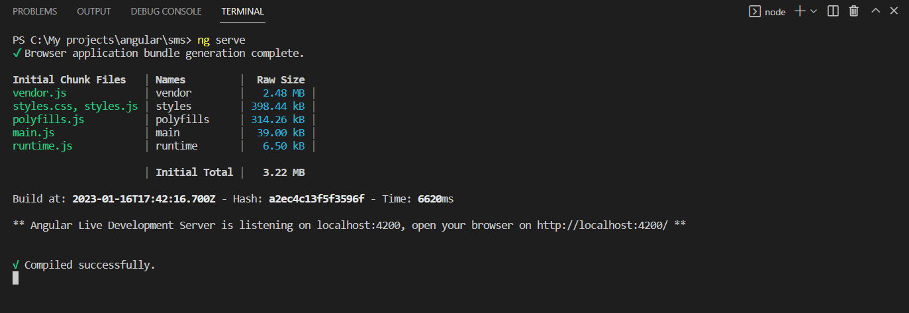
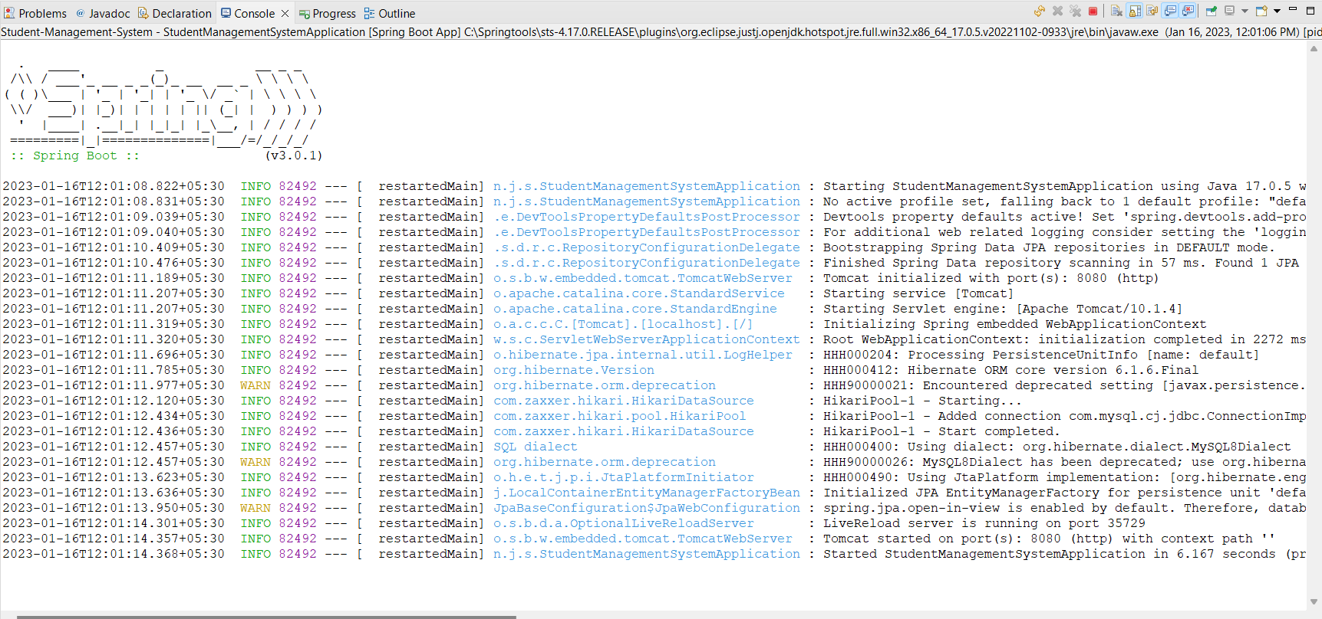
Running Status
FrontEnd
BackEnd

Slide 7
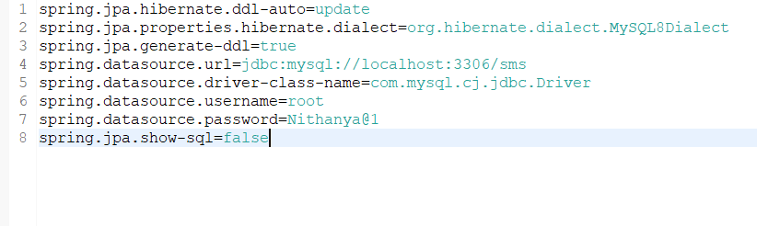
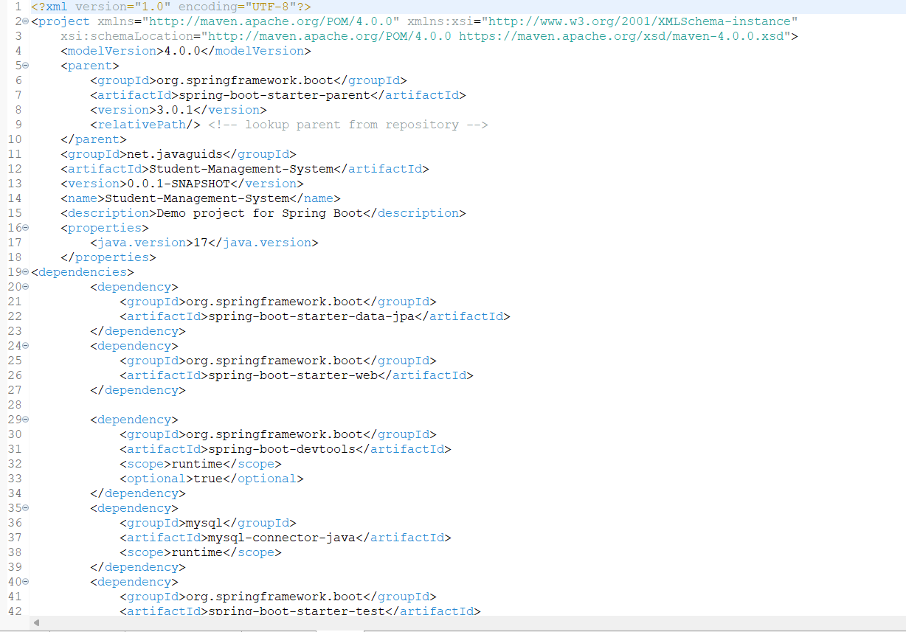
Properties and Dependency

Slide 8
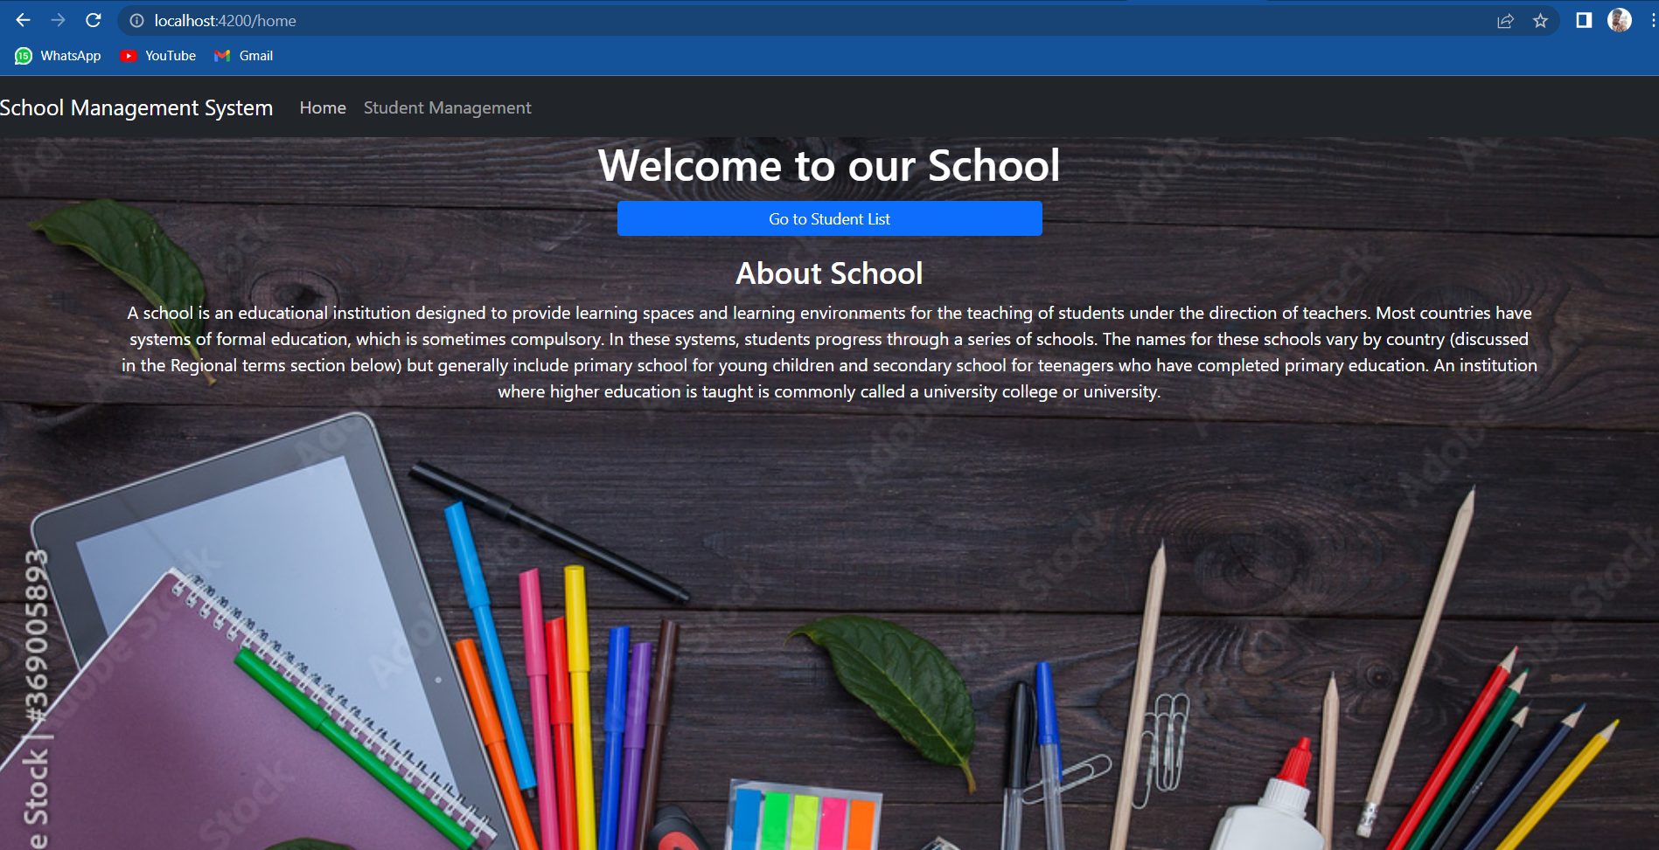
Home page

Slide 9
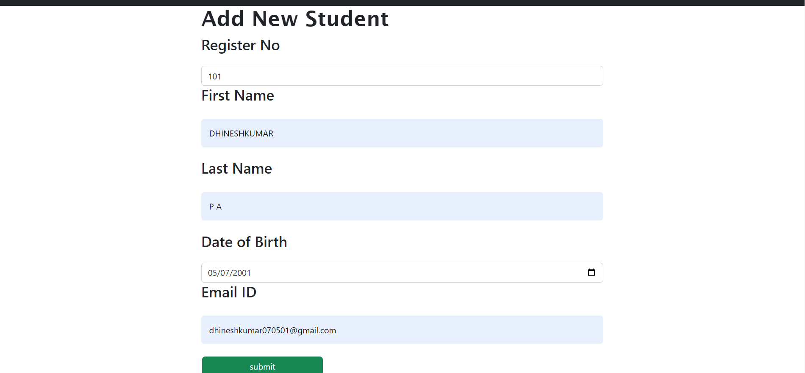
Add Student

Slide 10
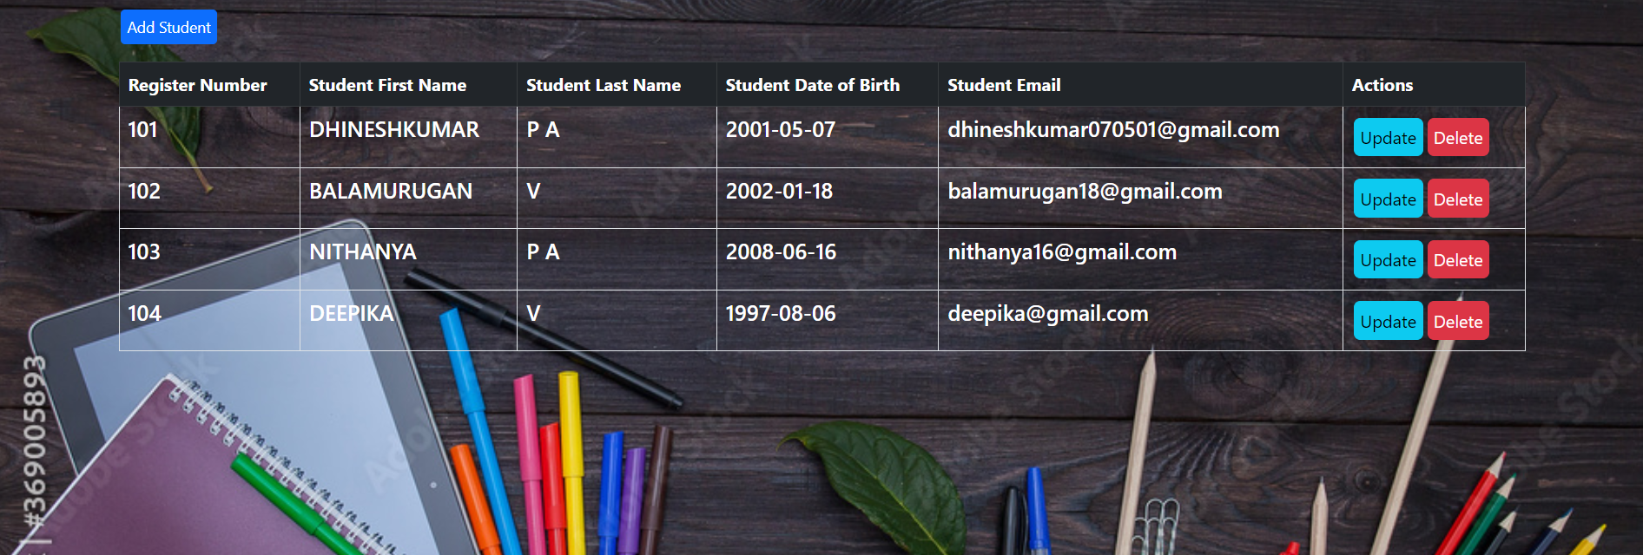
Student List

Slide 11


